Slide 1

Bicycle & Co.
Annual Sales
Dashboard
Presentation By:
BIGYANDUTT PANDA

Slide 2


Objective
The primary objective of analysing the bicycle shop sales data is to identify key drivers of revenue and profitability, understand customer behaviour, and optimize sales strategies.
The analysis also aims to identify seasonal trends and market opportunities to enhance overall business performance and growth.

Slide 3



Approach
Here are the steps & Approach of How i worked on this specificproject:-
Structuring the Dashboard: Started with PowerPoint for layout design, then moved to Excel
Pivot Tables & Formulas: Utilized Pivot Tables, along with functions like INDEX-MATCH to display real-time data.
Visual Enhancements: Added charts like Stacked Columns, Bar Charts, Tree Maps, and Donut Charts for a comprehensive view.
Interactive Slicers: Integrated slicers for seamless filtering, enhancing data interaction.

Slide 4
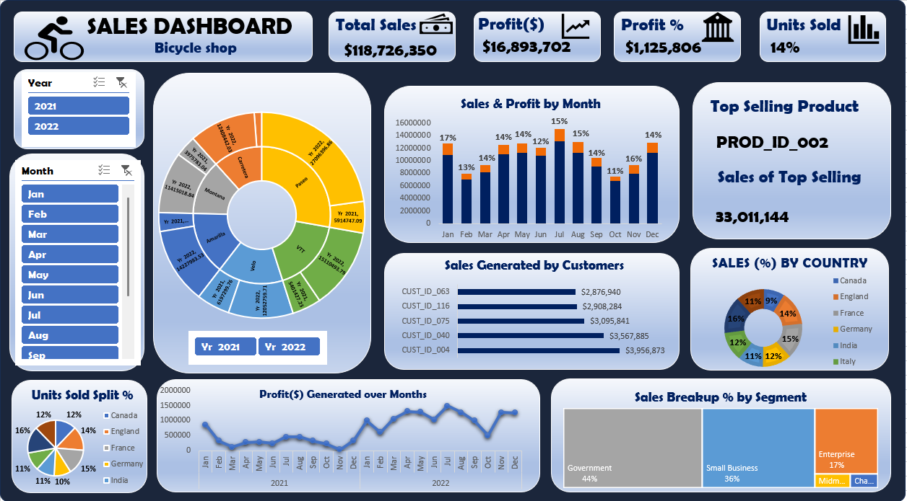
Dashboard

Slide 5

KPI’s
Total Sales: $118,726,350
Profit: $16,893,702
Profit Percentage: 14%
Profit Value: $1,125,806
Top Selling Product: Product ID PROD_ID_002
Top Customers: CUST_ID_004
Sales by Country: Highest in the USA with 16% and lowest in Italy with 9%
Sales by Segment: Government leads with 44%, followed by Small Business (36%).

Slide 6


Insights
Sales and Profit by Month: The highest sales and profit percentage occurred in July (15%) and August (16%).
Yearly Comparison: A sunburst chart visually compares 2021 and 2022 sales, with a significant increase in 2022.
Sales by Country: The US leads sales, followed by Germany and France, indicating potential market focus areas.
Sales by Segment: Government is the most profitable segment, contributing the most to overall sales, which suggests a focus on B2G (Business to Government) strategies.

Slide 7

Thank You
Presentation By:
BIGYANDUTT PANDA

